Slide 1

Codergirl – Frontend
Unit 2 - Class 6
December 16, 2020
Notes:
1

Slide 2
Agenda
Section 9 - Services and Dependency Injection (DI)
Studio – Assignment 5 and Section 10
Holiday break is 12/28 to 12/30, with the last class being 12/23 and the first of new year being on 1/4/21
Notes:
2

Slide 3
What have we learnt so far
Angular application - module and loading.
Angular CLI
Creating new app
Serving an app
Creating Components
Creating directives
Angular Components
Databinding
Nesting
Selectors
Course Project and Assignments.
Bootstrap basics.
Debugging.
Inbuilt and Directives and Custom Directives.
Also reverse engineering concepts.
Notes:
3

Slide 4
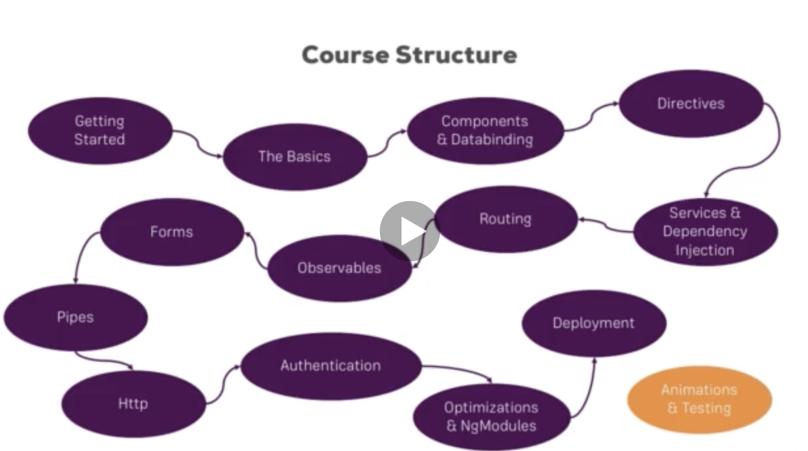
What have we learnt so far
Notes:
4

Slide 5
Services
Repeating similar information or reusable data. Service is another class that provides essential info.
DRY – Don’t repeat yourself.
Copy - Paste
Example – Logging Service.
Data service as the setup to pass around can be complicated!
Notes:
5

Slide 6
Services
logging.service.ts in app folder
export class LoggingService
Just a normal ts class to use
Notes:
6

Slide 7
Using Services – Incorrect way
Invoke the service can be done like this.
Angular creates a better way.
Notes:
7

Slide 8
Using Services – Correct way
Dependency Injector
Injected dependent class instances
Angular figures that out if you declare those dependencies in the constructor of the class dependent
Angular creates the instances of our Components and constructs them.
Notes:
8

Slide 9
Using Services – Correct way
Notes:
9

Slide 10
Using Services – Correct way
Notes:
10

Slide 11
Data service
Store and Manage data
Account is stored in app component and chain of property binding to save and pass data.
Instead, we can use an Accounts Service.
Simplify the code.
Notes:
https://basarat.gitbook.io/typescript/future-javascript/classes#access-modifiers
https://medium.com/young-coder/private-fields-in-typescript-3-8-true-privacy-at-last-fb4f194305d9
11

Slide 12
Accounts service
Create accounts.service.ts
Create new class called AccountsService
Copy accounts from app.components.ts
Notes:
https://basarat.gitbook.io/typescript/future-javascript/classes#access-modifiers
https://medium.com/young-coder/private-fields-in-typescript-3-8-true-privacy-at-last-fb4f194305d9
12

Slide 13
app.component.ts
Notes:
https://basarat.gitbook.io/typescript/future-javascript/classes#access-modifiers
https://medium.com/young-coder/private-fields-in-typescript-3-8-true-privacy-at-last-fb4f194305d9
13

Slide 14
Clean up code in new-account.component.ts
Remove event code from new-account.component.ts
And use AccountsService
Notes:
https://basarat.gitbook.io/typescript/future-javascript/classes#access-modifiers
https://medium.com/young-coder/private-fields-in-typescript-3-8-true-privacy-at-last-fb4f194305d9
14

Slide 15
Clean up code in account.component.ts
Remove event code from account.component.ts
And use AccountsService
Notes:
https://basarat.gitbook.io/typescript/future-javascript/classes#access-modifiers
https://medium.com/young-coder/private-fields-in-typescript-3-8-true-privacy-at-last-fb4f194305d9
15

Slide 16
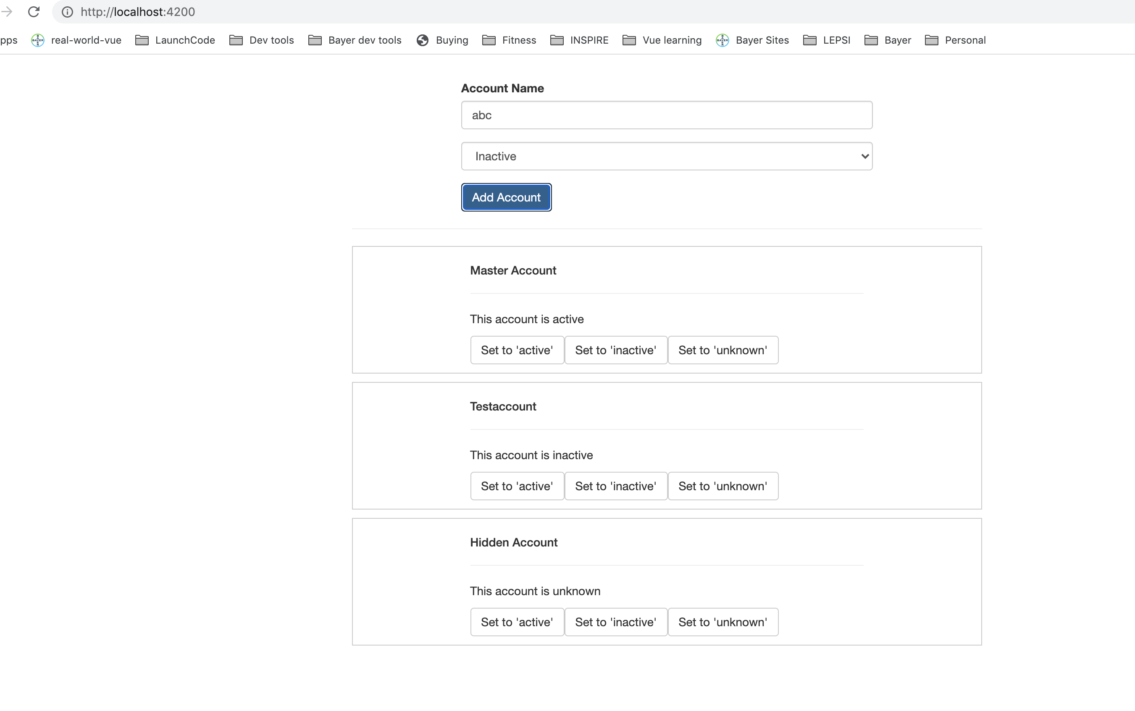
App is broke!
New account is not being added to Accounts. Something is wrong!
Notes:
https://basarat.gitbook.io/typescript/future-javascript/classes#access-modifiers
https://medium.com/young-coder/private-fields-in-typescript-3-8-true-privacy-at-last-fb4f194305d9
16

Slide 17
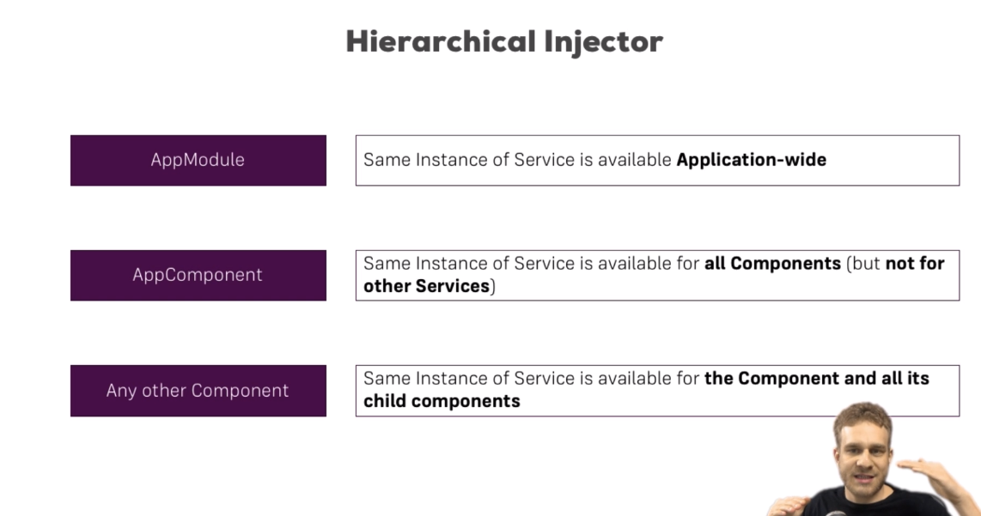
Hierarchical Injector
Notes:
https://basarat.gitbook.io/typescript/future-javascript/classes#access-modifiers
https://medium.com/young-coder/private-fields-in-typescript-3-8-true-privacy-at-last-fb4f194305d9
17

Slide 18
Fixing the AccountsService usage
Right now – AppComponent has its own instance
As well as new-account and account have its own instance.
To fix this – remove from providers array but not constructor.
Understand if you want same instance of service or different instances.
We could move the AccountsService from the providers in app.component.ts to the app.module.ts
Now whole application gets same instance.
Can inject services into another service by adding that in the constructor of the dependent service. However, some meta-data is needed. @Injectable()
Recommended to use @Injectable everywhere.
Notes:
https://basarat.gitbook.io/typescript/future-javascript/classes#access-modifiers
https://medium.com/young-coder/private-fields-in-typescript-3-8-true-privacy-at-last-fb4f194305d9
18

Slide 19
Add LoggingService into AccountsService
Notes:
https://basarat.gitbook.io/typescript/future-javascript/classes#access-modifiers
https://medium.com/young-coder/private-fields-in-typescript-3-8-true-privacy-at-last-fb4f194305d9
19

Slide 20
Add LoggingService into AccountsService
Notes:
https://basarat.gitbook.io/typescript/future-javascript/classes#access-modifiers
https://medium.com/young-coder/private-fields-in-typescript-3-8-true-privacy-at-last-fb4f194305d9
20

Slide 21
Summary
Don’t need to chain with property and event binding!
Services keep operations separate from data.
Cross component communication.
We will cover Observables later.
New versions of Angular @Injectable({providedIn: 'root'})
Notes:
https://basarat.gitbook.io/typescript/future-javascript/classes#access-modifiers
https://medium.com/young-coder/private-fields-in-typescript-3-8-true-privacy-at-last-fb4f194305d9
21

Slide 22
Questions?

Slide 23
Studio
Assignment 5: Practicing Services
Section 10: Course Project - Services & Dependency Injection

